Slide 1
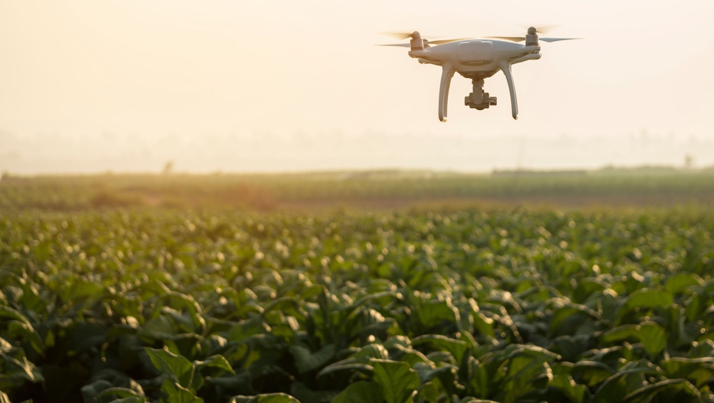
A drone named “Spicy“…
Philip Witte

Slide 2
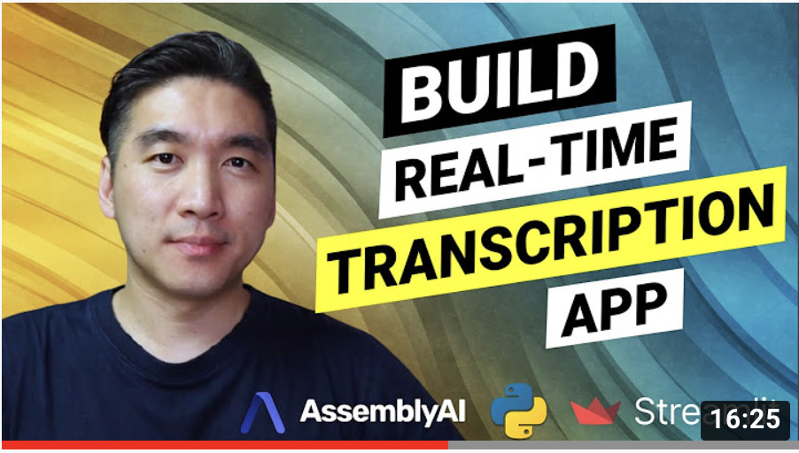
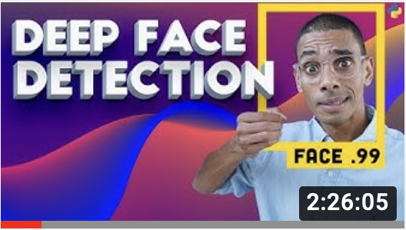
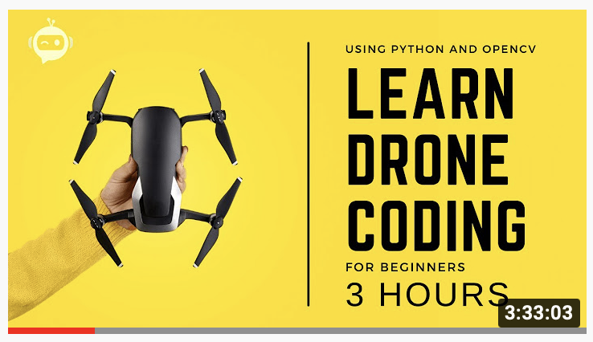
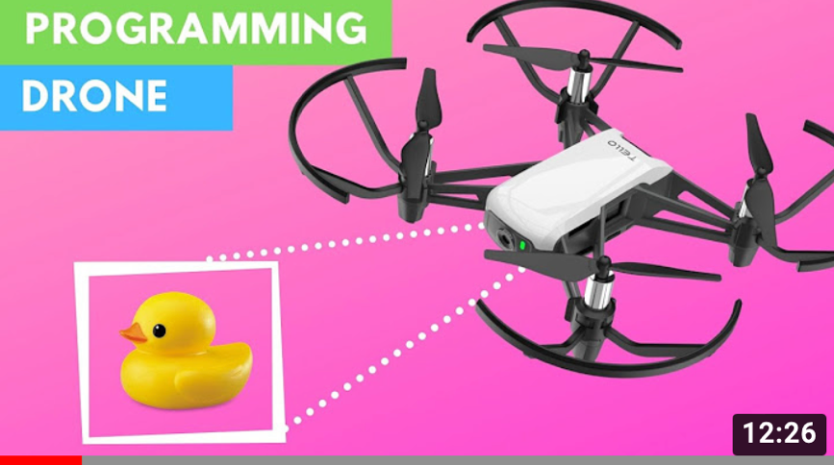
CNNs are fascinating – what could I do with it?
Source: youtube

Slide 3
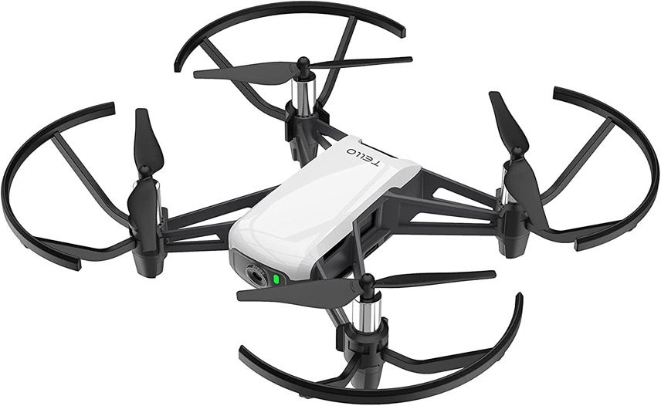
A drone named “Spicy”
Tello drone
Key features
Voice control leveraging AssemblyAI API
Face tracking using a face detection model built from scratch
Hand gesture control leveraging MediaPipe‘s holistic model
OpenCV

Slide 4
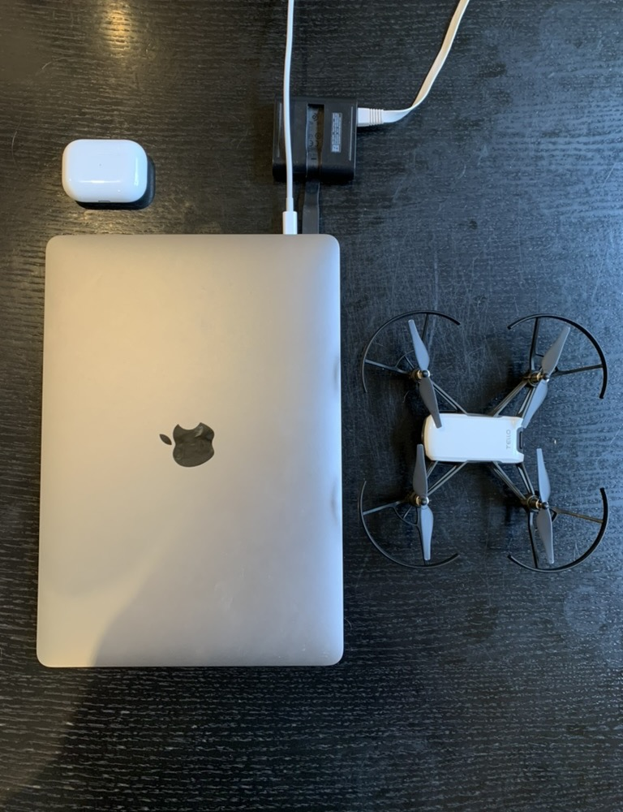
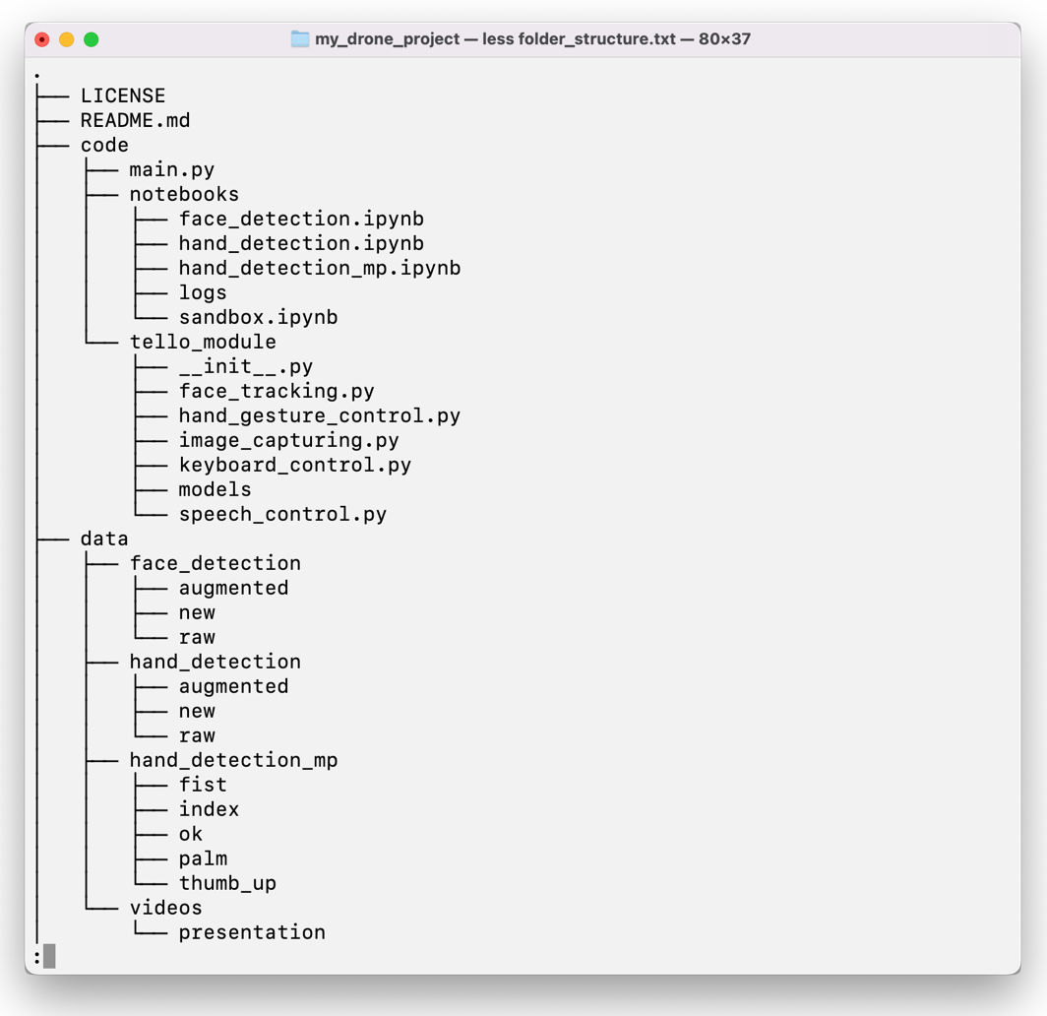
Prerequisites & structure

Slide 5
Voice control Face tracking Gesture control

Slide 6
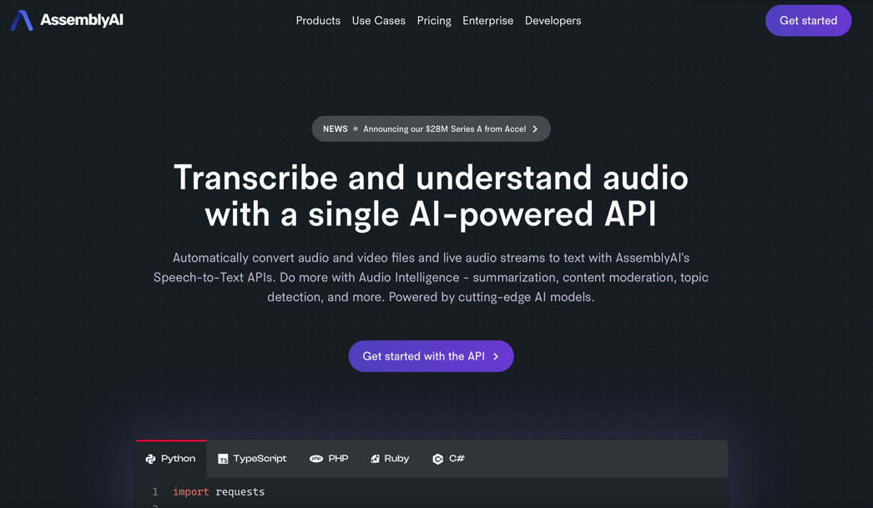
Voice control serves as the main interface
How?
Leveraging AssemblyAI API and Async IO (a concurrent programming design)
Why?
Serves as main interface
Control drone more independently
Allow switching between modes

Slide 7
Voice control Face tracking Gesture control

Slide 8
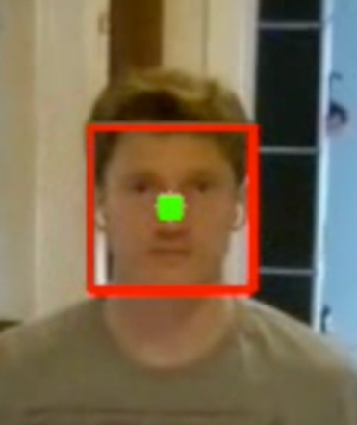
Face tracking – basic idea (1/2)
Approach
Identify face
Draw boundary box
Determine center point
Move drone to align center point and center of camera (turn/up/down)
PD control is used (i.e. error + previous error)
Drone camera/view

Slide 9


Face tracking – basic idea (2/2)
Approach
Identify face
Draw boundary box
Calculate area of boundary box
Keep area constant (predefined value) by moving the drone forward/backward
PD control is used (i.e. error + previous error)
Drone camera/view

Slide 10
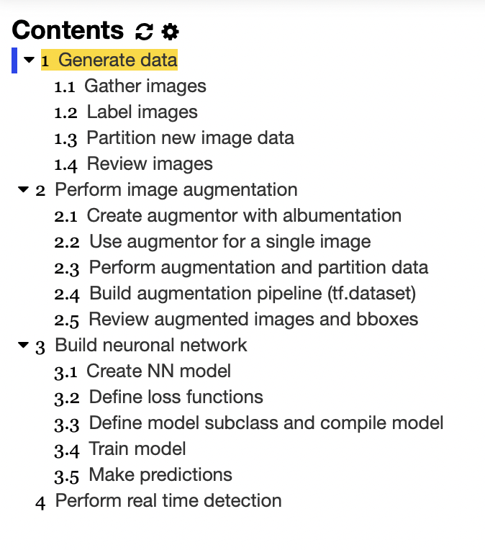
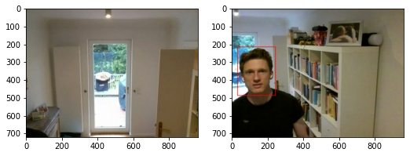
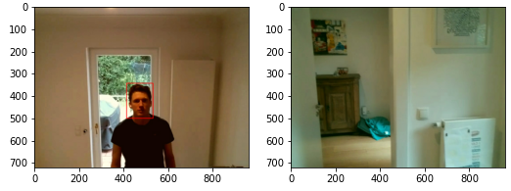
Face tracking – workflow/generate data

Slide 11
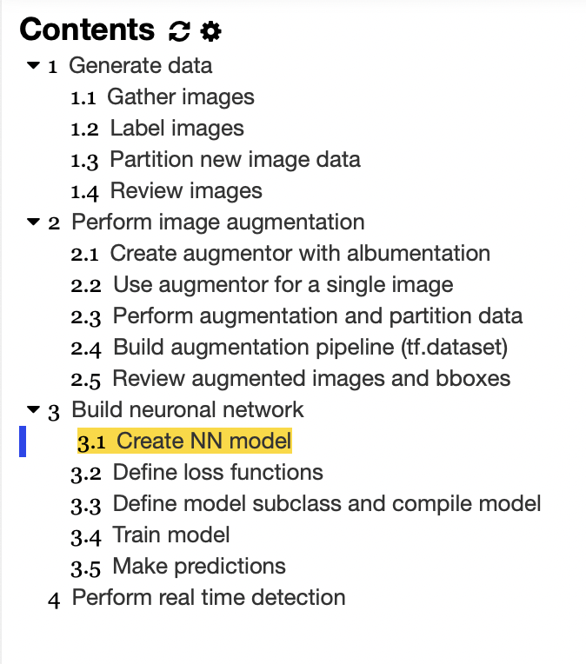
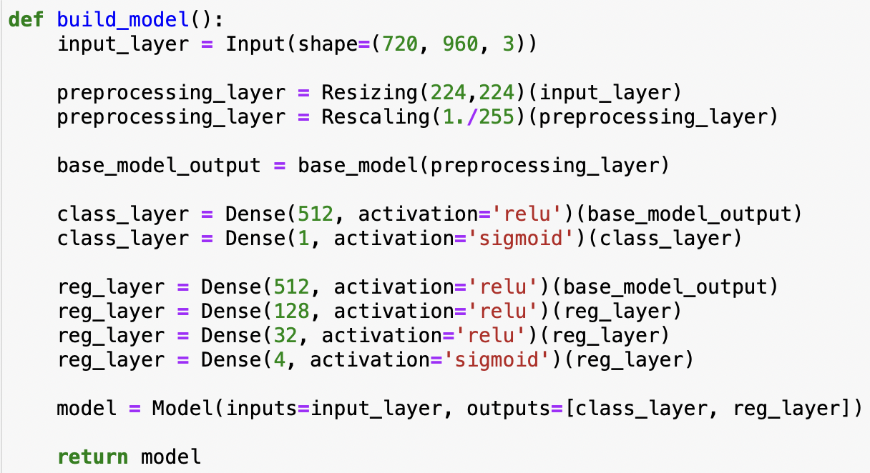
Face tracking – workflow/create network
Remark: Tried ‘Mobilenet’ and ‘VGG16’ as ‘base_model’ – vgg16 performed better

Slide 12
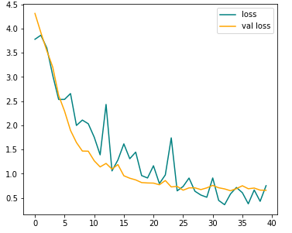
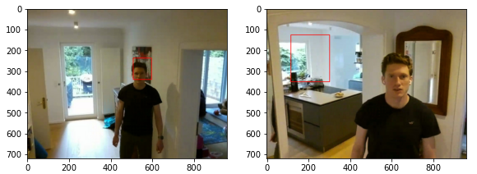
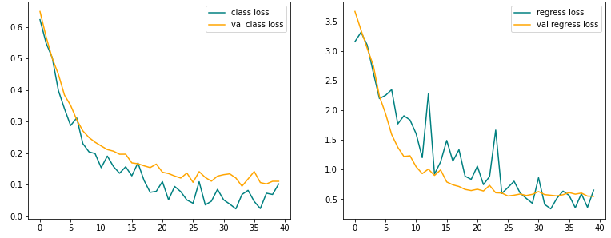
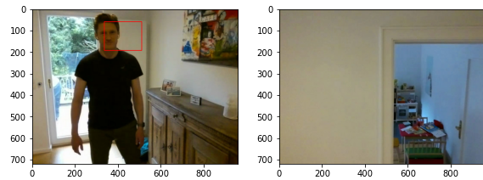
Face tracking – result “needs improvement”
Total loss
?
Class loss
Regression loss

Slide 13
Face tracking – demo (w/ OpenCV model)
See video folder -> „face_tracking_short“

Slide 14
Voice control Face tracking Gesture control

Slide 15
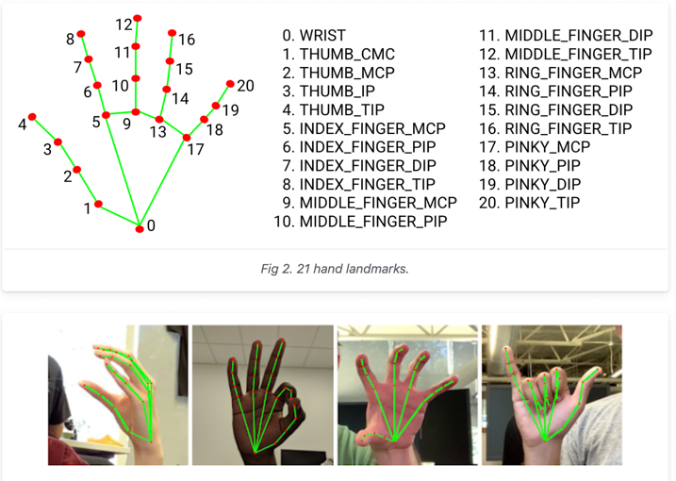
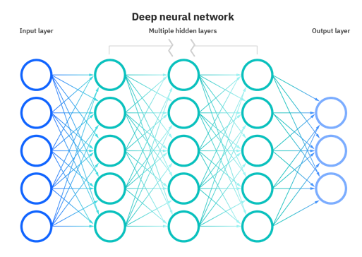
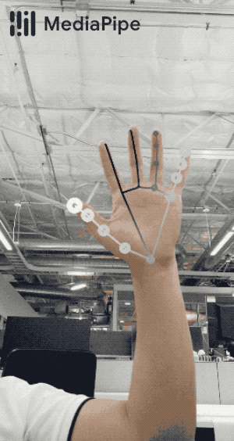
Gesture control – basic idea
Deep neuronal network
Mediapipe
hand model
Gesture recognition!

Slide 16
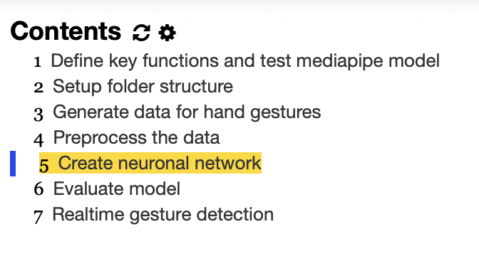
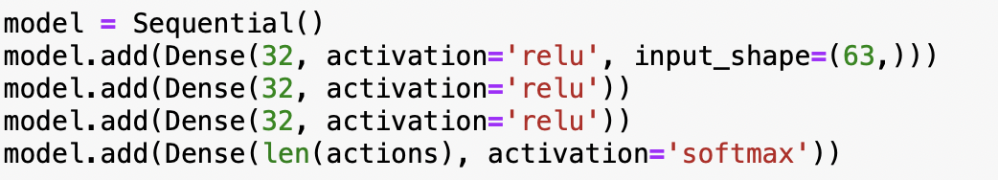
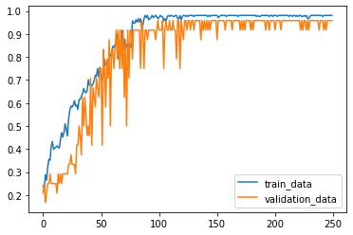
Gesture control – workflow/create network

Slide 17
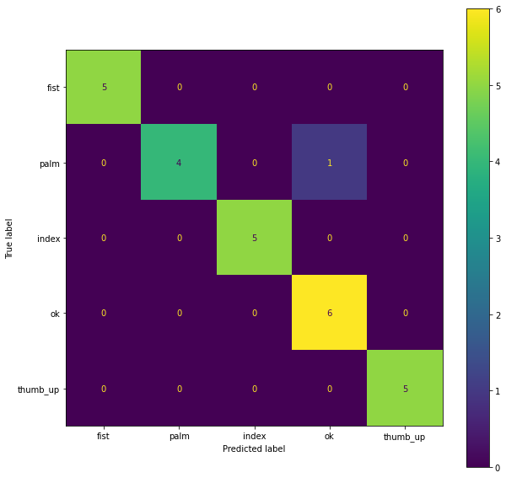
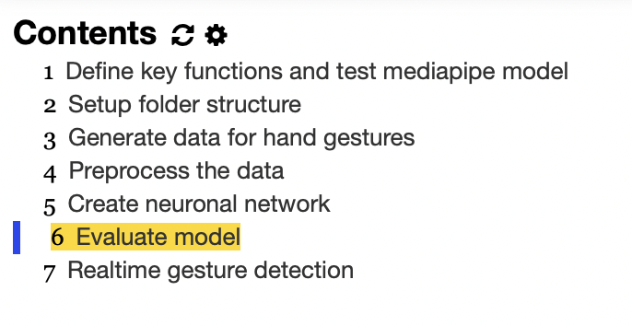
Gesture control – results

Slide 18
Gesture control - demo
See video folder -> „gesture_control_short“

Slide 19
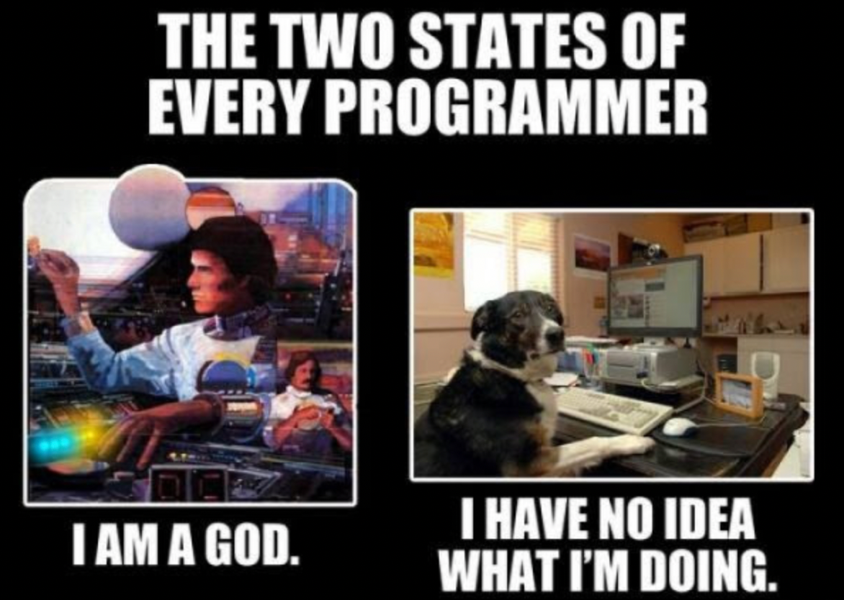
Thanks, Spiced Academy!
Source: https://kekememes.de/picture/the-two-states-of-every-programmer-have-no-idea-1ama-eXjb8hWM8

Slide 20
Backup

Slide 21
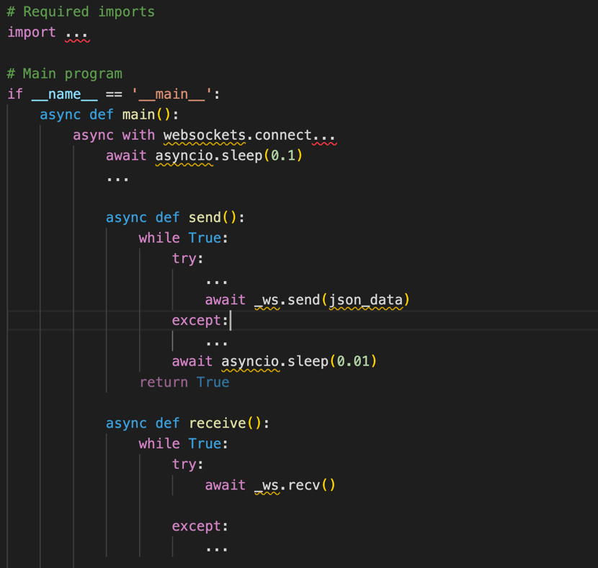
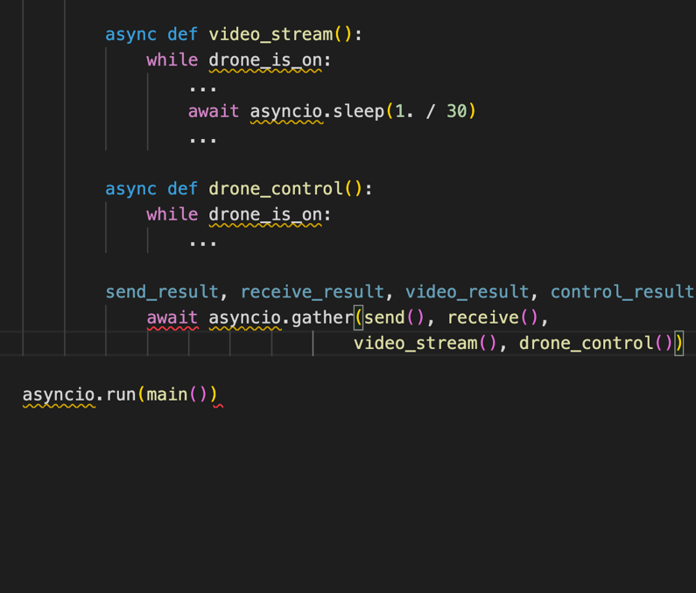
Voice control – 4 main „async"routines
main.py as pseudo code

Slide 22
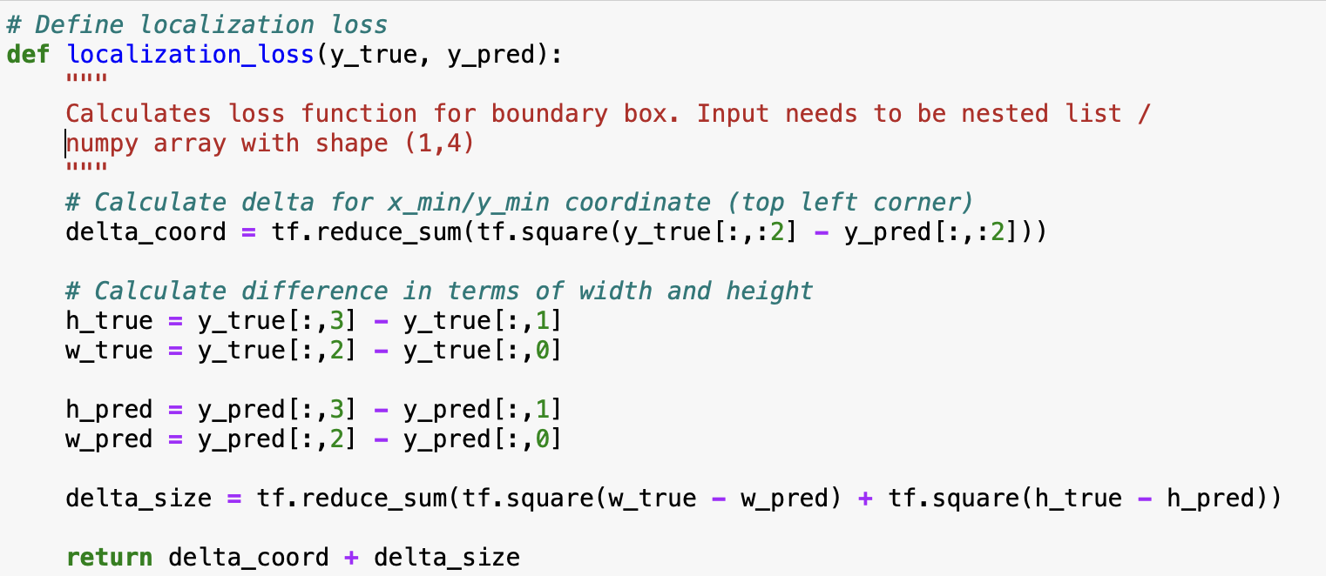
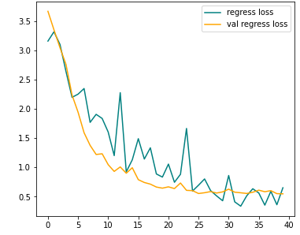
Face tracking – loss function for regression
Regression loss

